Slide 1

A Deep Learning-Based Dual Latent Space Method for the Estimation of Physical Flow Properties from Fiber-Optic Measurements
August 14th-15th 2023
Misael M. Morales, Carlos Torres-Verdín, and Michael Pyrcz
The University of Texas at Austin
23rd Annual Formation Evaluation Research Consortium Meeting (2023)

Slide 2
Table of Contents
2
Introduction and Motivation
Fiber-Optic Sensing
Experimental System
Dimensionality Reduction Techniques
Dual Latent Space Method
Results and Discussion
Conclusions and Future Work

Slide 3
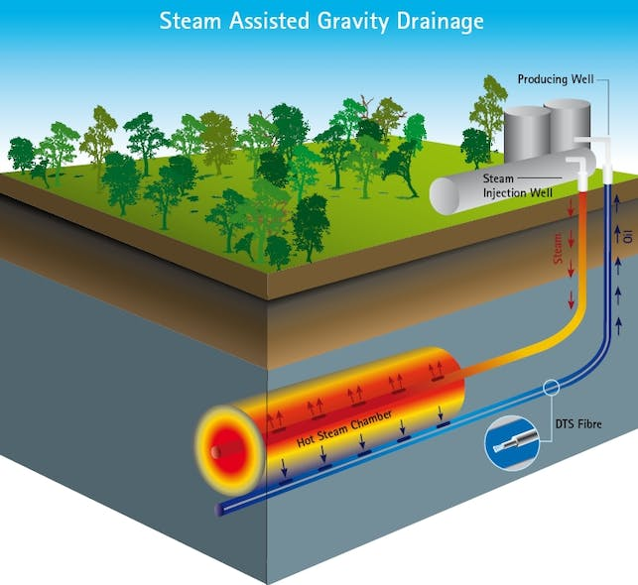
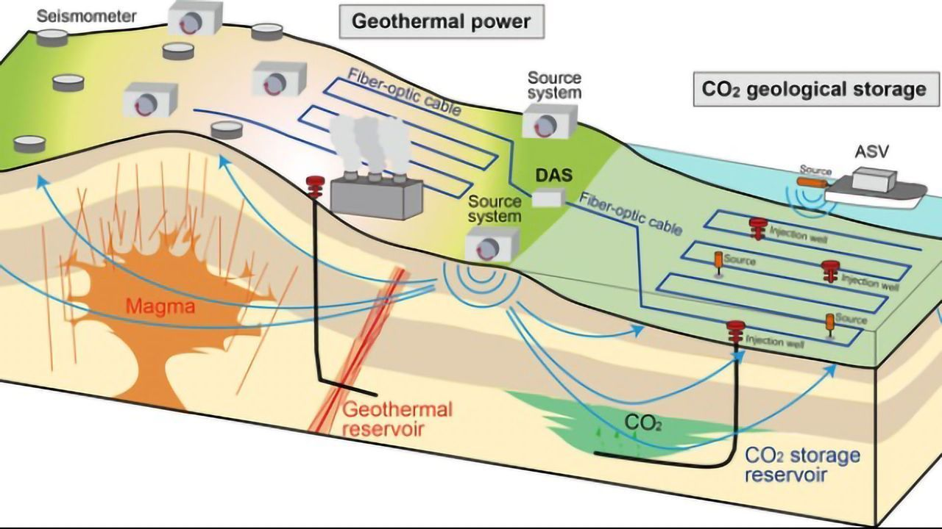
Introduction and Motivation
3
Digital revolution enables better subsurface profiling
Data science techniques help processing and interpretation
Fiber optics enables reliable, cost-effective, and detailed monitoring
Applications in geothermal, CCUS, hydraulic fracturing, EOR, etc.
→ Large volumes of data

Slide 4
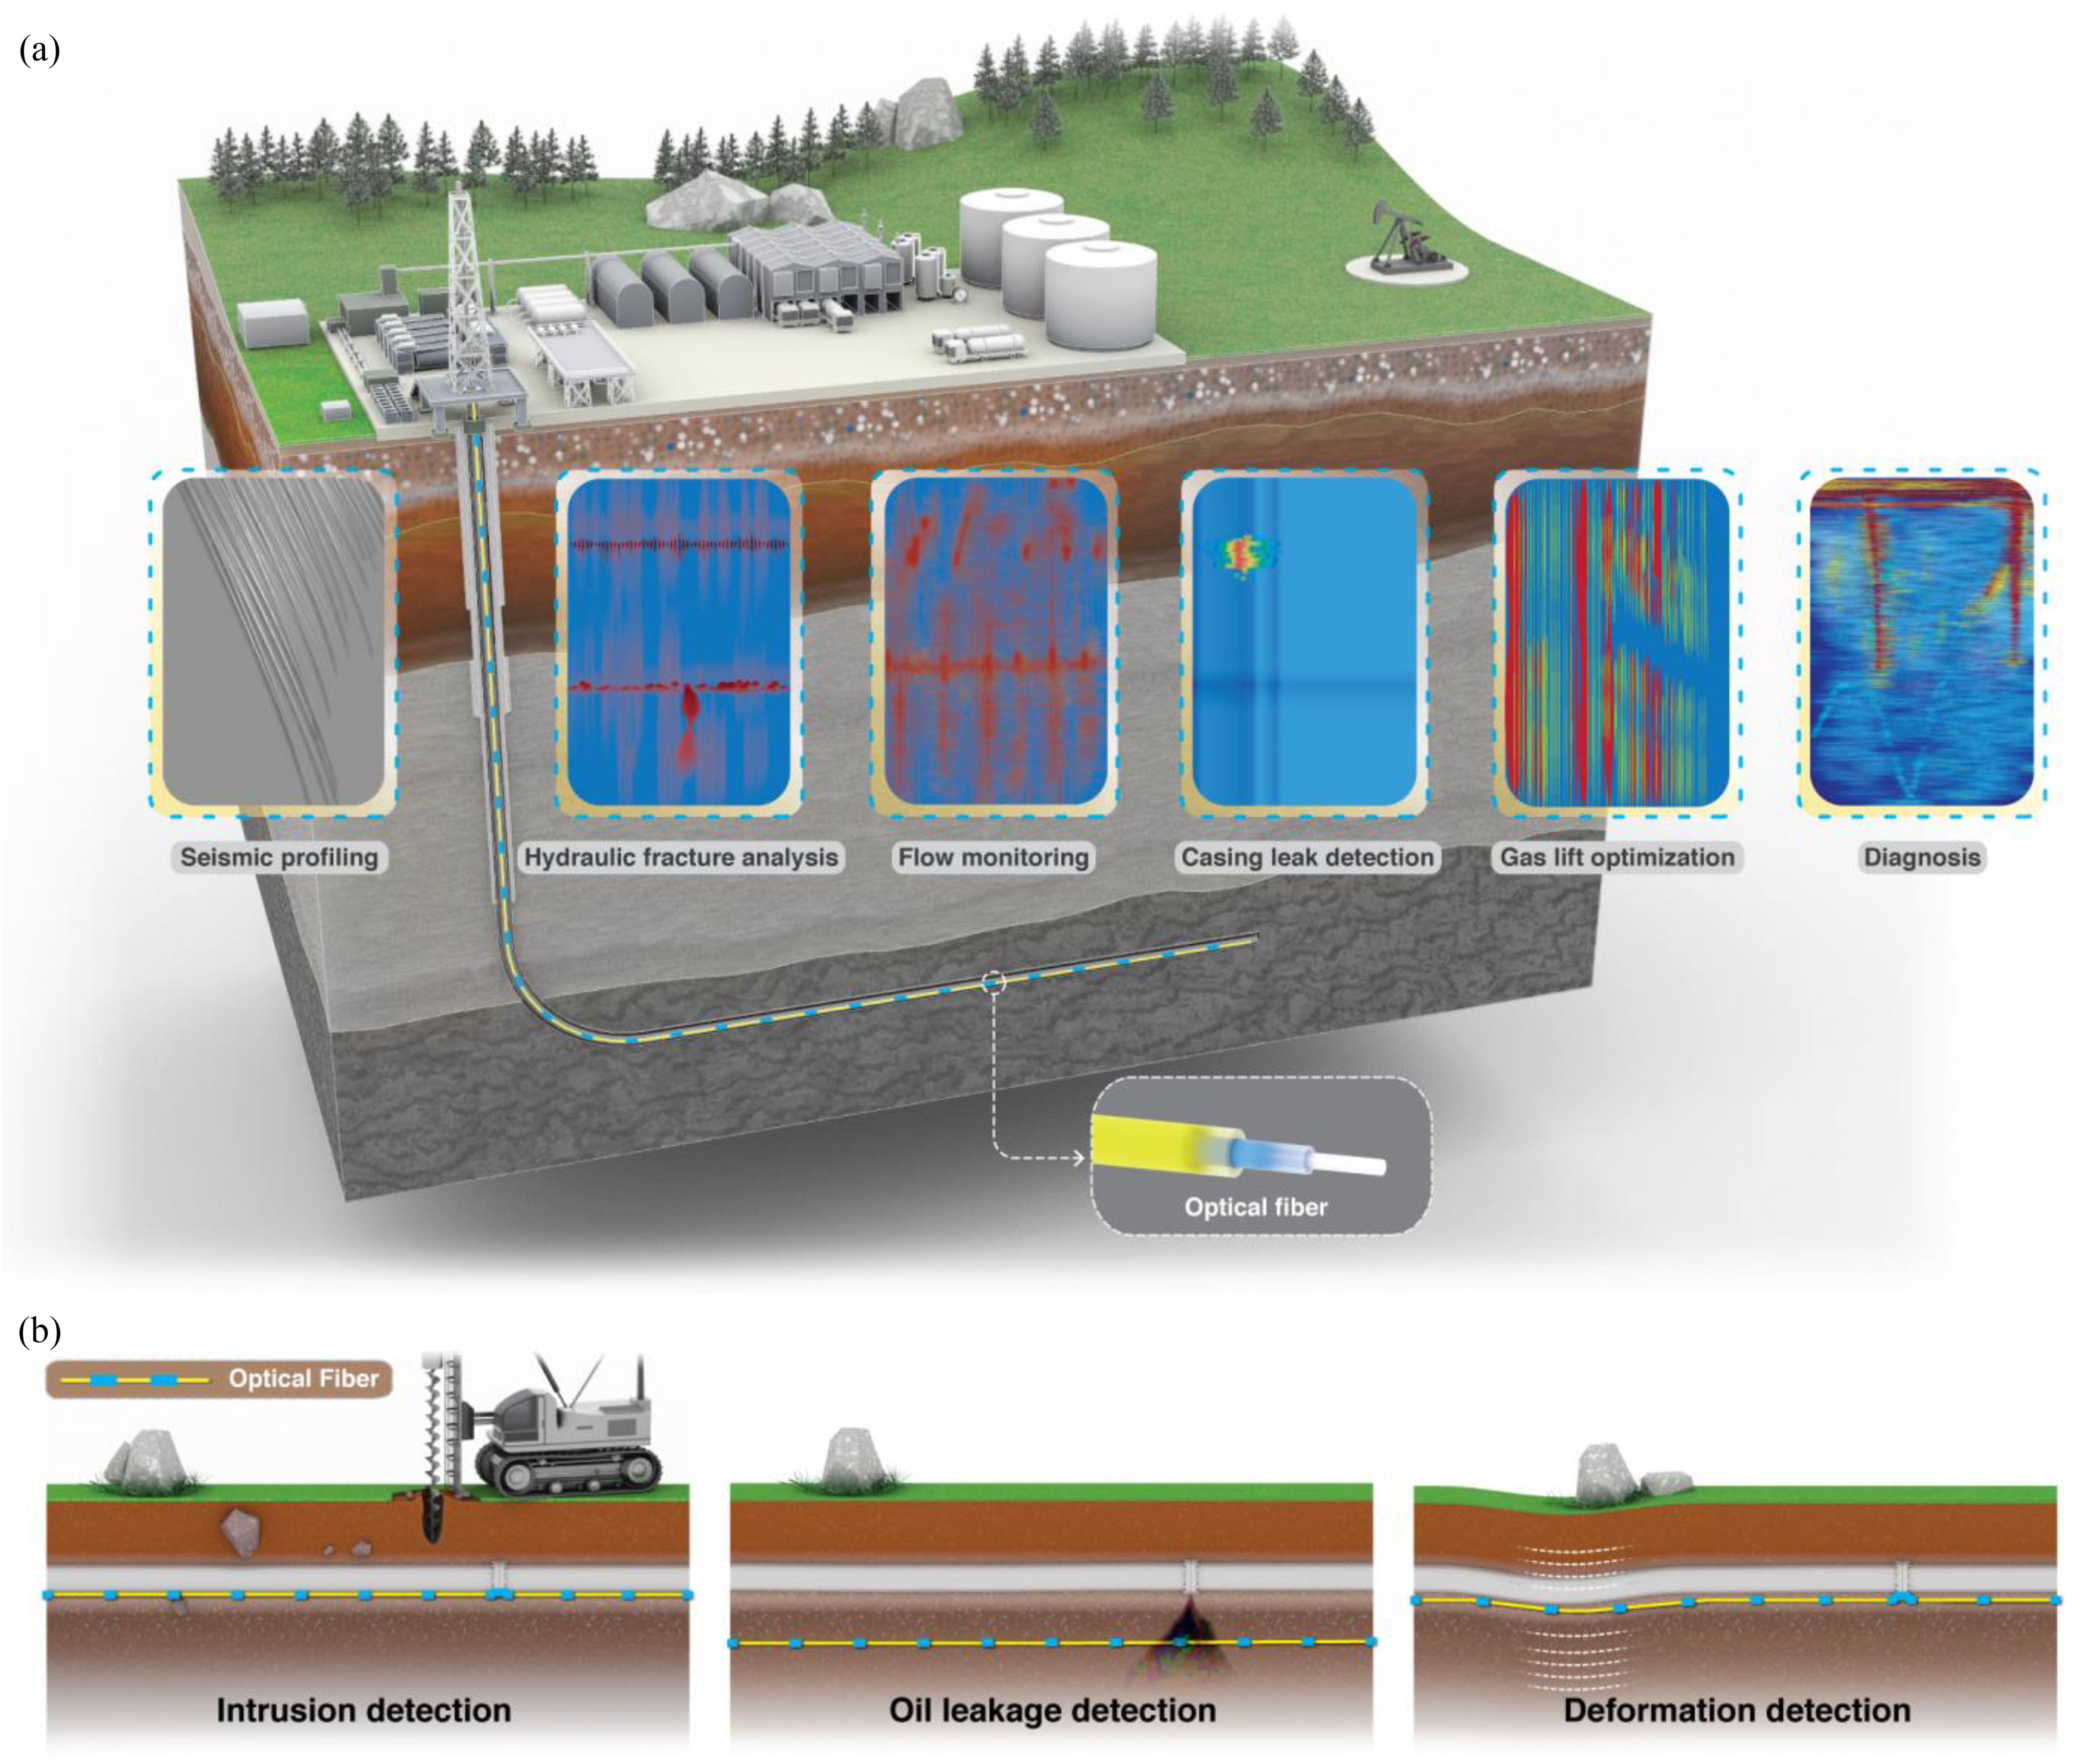
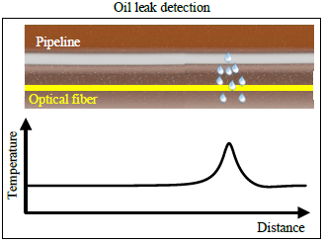
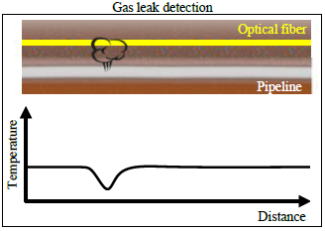
Fiber-Optic Sensing: Pros and Cons
4
Distributed Acoustic (DAS) and Temperature (DTS) Sensing
DAS: continuous measurement of axial strain along the fiber
DTS: continuous measurement of temperature profile along the fiber

Slide 5
Fiber-Optic Sensing
5
Cost-effective and high-resolution alternative for downhole monitoring
Distributed Acoustic (DAS) and Temperature (DTS) Sensing
Data-driven dimensionality reduction for improved processing and analysis
Advantages:
No moving parts
No downhole electronics
Deployed throughout wellbore
Challenges:
Sensitivity to noise
Sensor reliability
Real-time event detection
Data volume

Slide 6

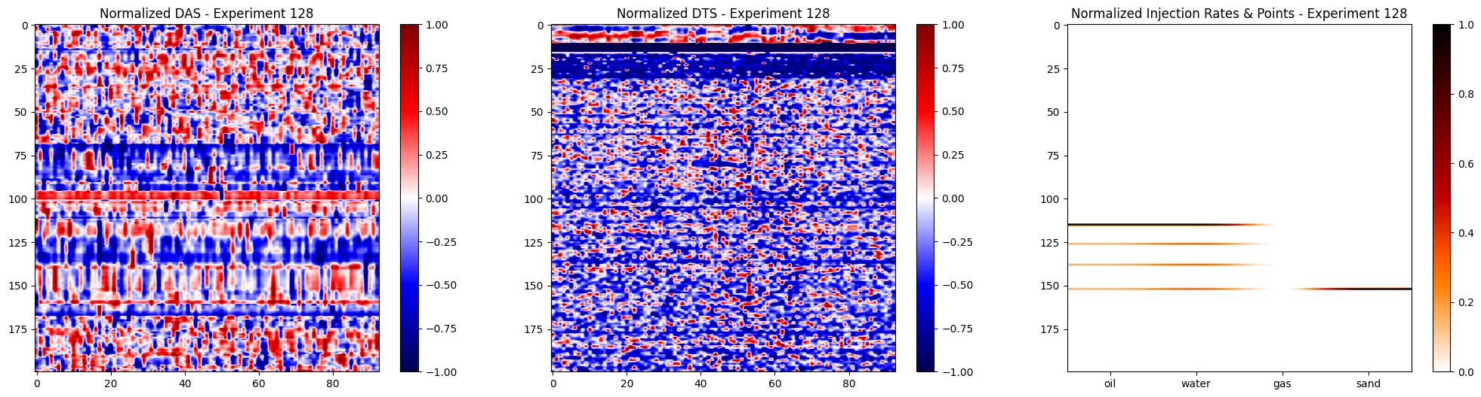
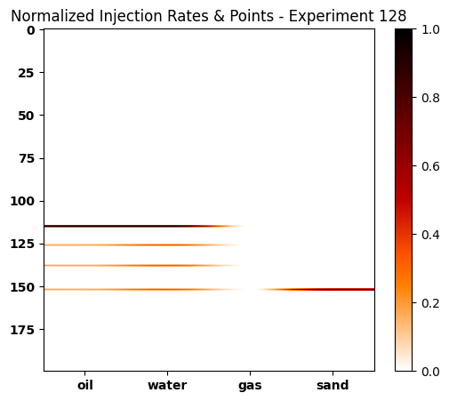
Experimental Design
6
In collaboration with:
50-meter flow loop with internal and external tubing:
Background + 4 perforations flowing O/G/W/Sandstone
Fiber optic cable in annulus recording DAS and DTS
Injection points
F.O. cable
Background:
O – 3,000
W – 0
G – 100,000
S – 0
1
2
3
4
5,504 measurements
13 minutes, 10 kHz
Distance [m]
Injection 1:
O – 250
W – 250
G – 8,333.3
S – 0
Injection 2:
O – 250
W – 100
G – 8,333.3
S – 0
Injection 3:
O – 0
W – 0
G – 0
S – 0
Injection 4:
O – 250
W – 250
G – 8,333.3
S – 10
Time samples
Time samples

Slide 7
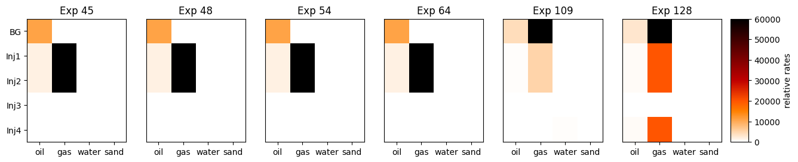
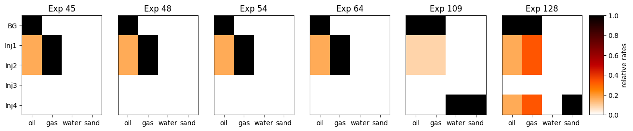
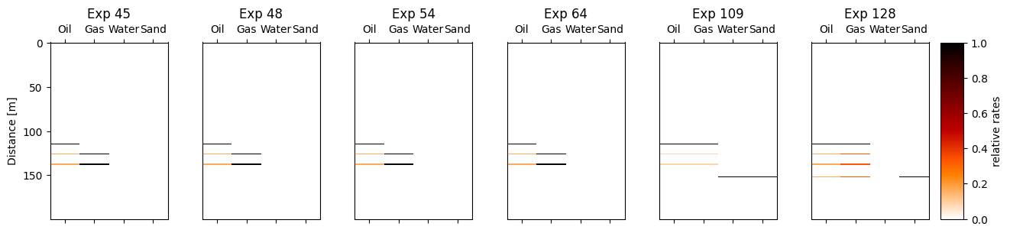
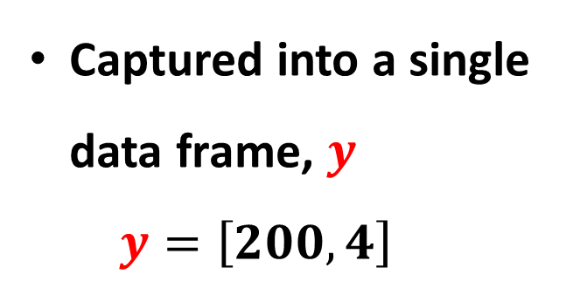
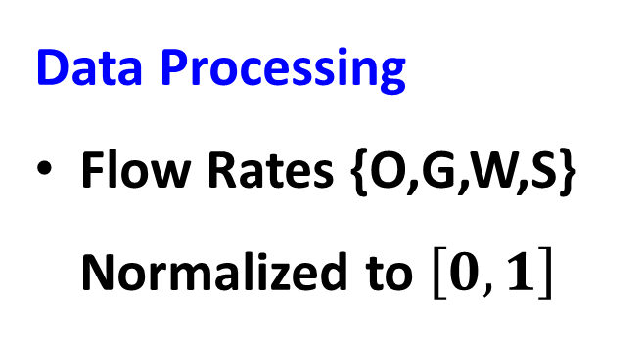
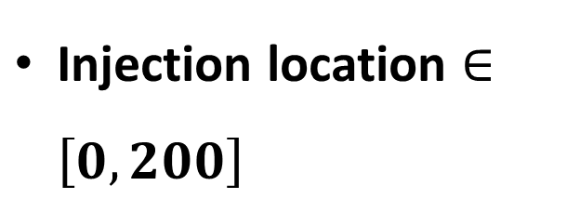
Experimental Design: Data Processing
7
Data Processing
Flow Rates {O,G,W,S} Normalized to $\left[0,1\right]$
Injection location $∈\left[0,200\right]$
Captured into a single data frame, $y$
$$y=\left[200,4\right]$$

Slide 8
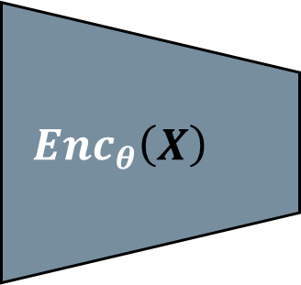
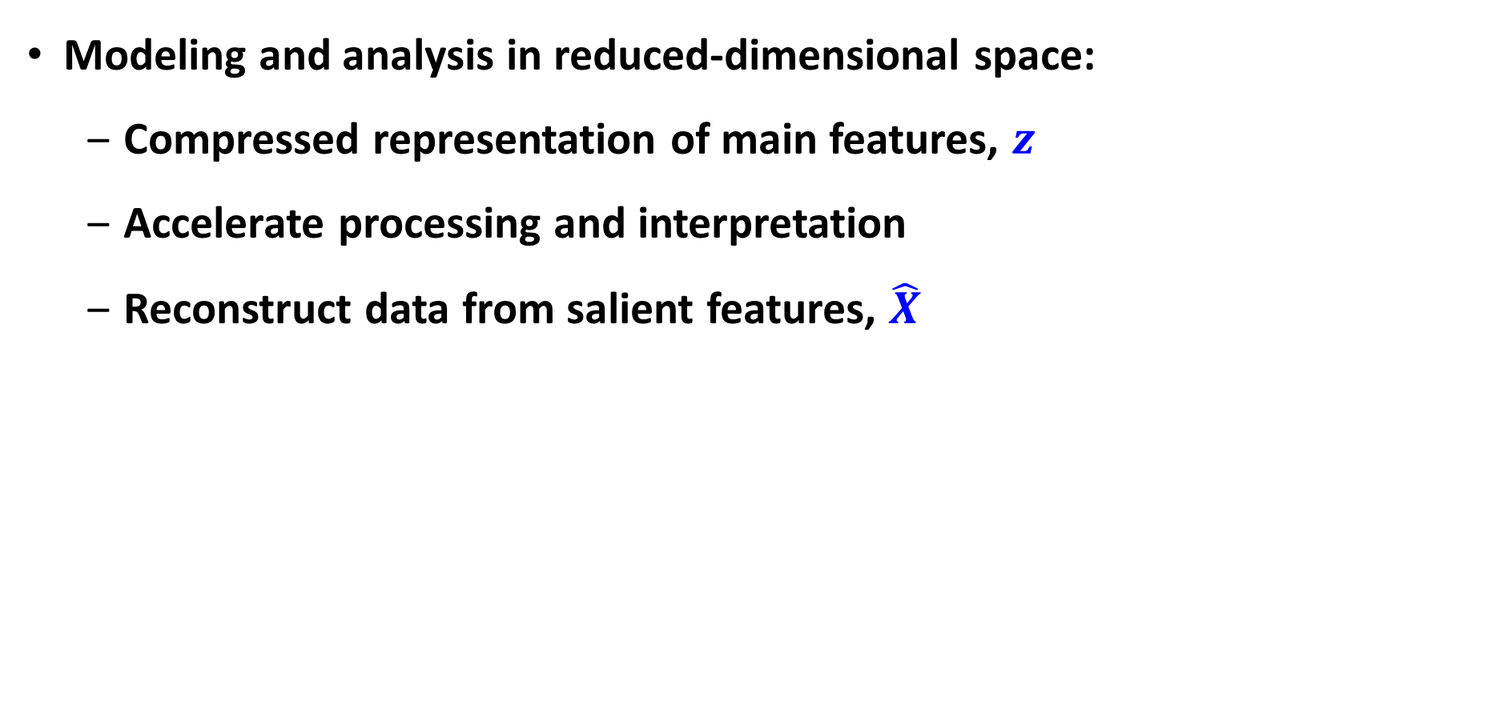

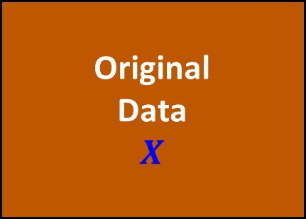
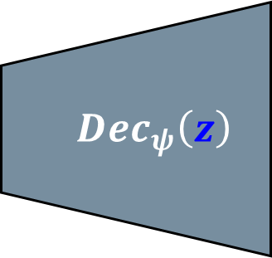
Dimensionality Reduction Techniques: Overview
8
Modeling and analysis in reduced-dimensional space:
Compressed representation of main features, $z$
Accelerate processing and interpretation
Reconstruct data from salient features, $\hat{X}$
Original
Data
$$X$$
$$Enc_{θ}\left(X\right)$$
$$Dec_{ψ}\left(z\right)$$
Reconstructed Data
$$\hat{X}$$
z

Slide 9
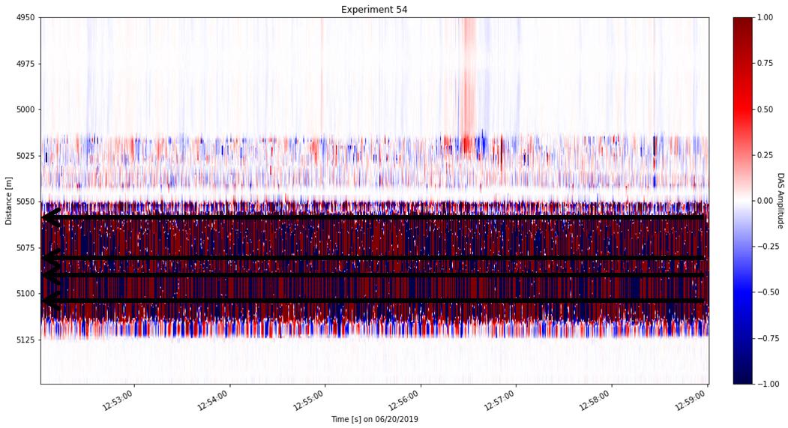
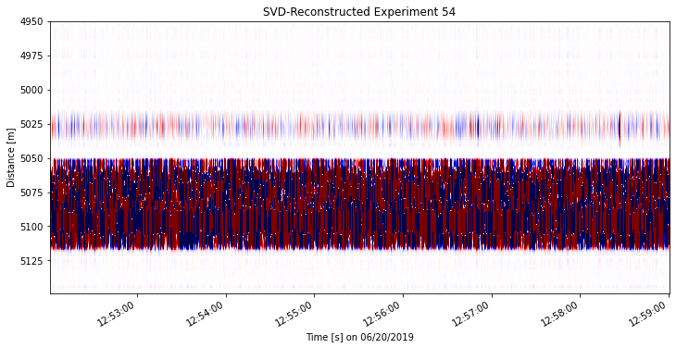
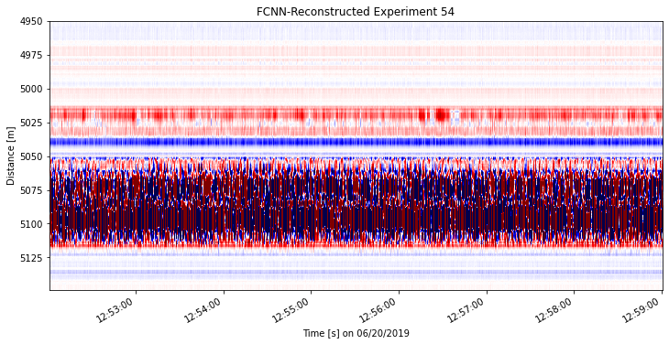
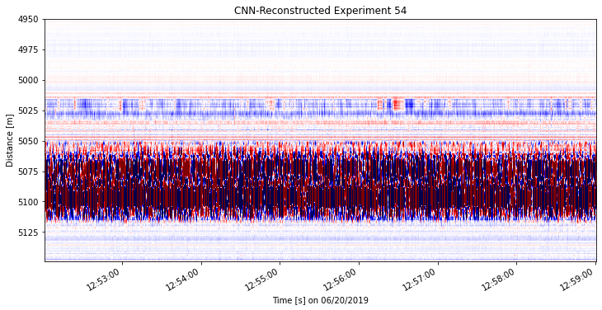
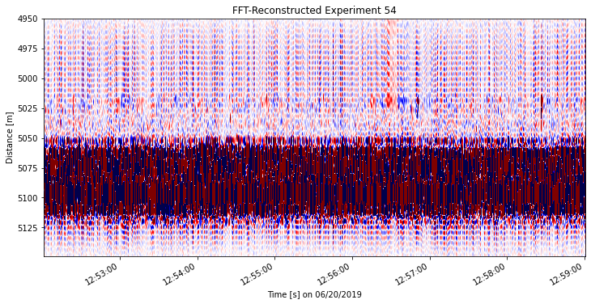

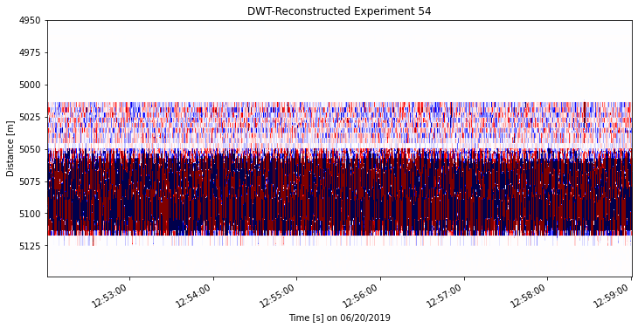
Dimensionality Reduction Techniques: Findings
9
Comparison of reconstructions at 5% compression ratio
Distance [m]
Time samples

Slide 10
Dimensionality Reduction Techniques: Comparison
10
Comparison of error metrics for dimensionality reduction techniques
Technique | Computing Time | Latent Dimension | MSE [] | SSIM [%] | PSNR [dB]
SVD | 6m 54s | 5% | 2.85-4 | 94.68 | 41.90
PCA | 7m 8s | 5% | 1.55e-4 | 95.49 | 44.12
FFT | 7m 20s | 5% | 3.79e-4 | 94.24 | 40.24
DWT | 6m 28s | 5% | 1.28e-4 | 96.71 | 44.95
DL-AE FCNN | 5m 14s | 5% | 1.97e-2 | 65.45 | 27.32
DL-AE CNN | 12m 16s | 5% | 1.52e-2 | 70.03 | 34.18

Slide 11
Dimensionality Reduction Techniques: Summary
11
PCA and SVD: not best-suited for time series analysis
Do not represent all physics in the dynamical system
FFT and DWT: best exploit time signals but generic basis not tailored to physics in the data
Leading methods for image/video processing
Deep Learning AutoEncoders:
Require expertise in design and training but incorporate all physics and dynamics in the time series data

Slide 12
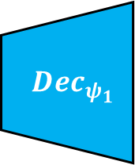
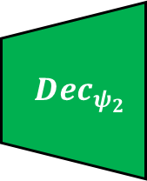
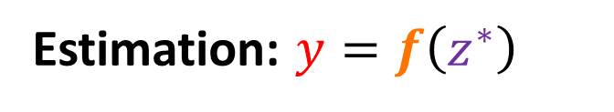

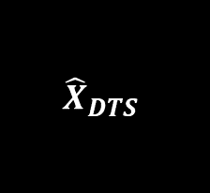
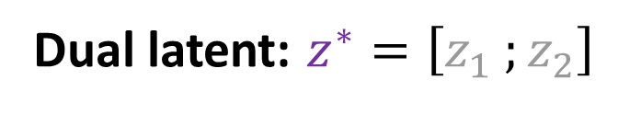
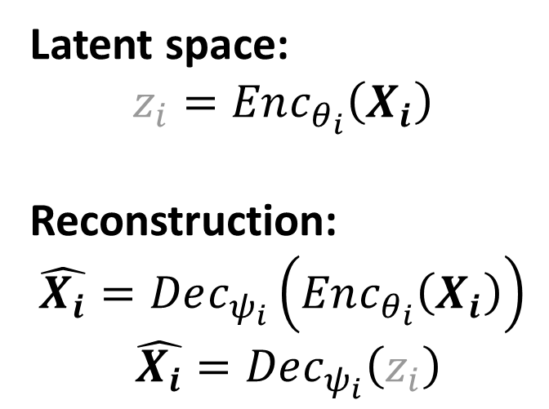







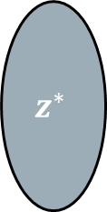
Dual Latent Space Method: Architecture
12
$$X_{DAS}$$
$$Enc_{θ_{1}}$$
$$Dec_{ψ_{1}}$$
$${\hat{X}}_{DAS}$$
Latent space:
$$z_{i}=Enc_{θ_{i}}\left(X_{i}\right)$$
Reconstruction:
$$\hat{X_{i}}=Dec_{ψ_{i}}\left(Enc_{θ_{i}}\left(X_{i}\right)\right)$$
$$\hat{X_{i}}=Dec_{ψ_{i}}\left(z_{i}\right)$$
$$z_{1}$$
$$⨂$$
$$X_{DTS}$$
$$Enc_{θ_{2}}$$
$$Dec_{ψ_{2}}$$
$${\hat{X}}_{DTS}$$
$$z_{2}$$
Dual latent: $z^{∗}=\left[z_{1} ;z_{2}\right]$
$$z^{∗}$$
Rates
and
Locations
Estimation: $y=f\left(z^{∗}\right)$

Slide 13
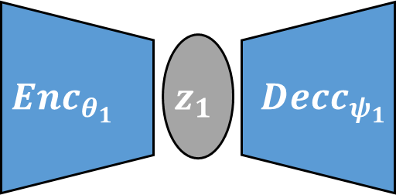
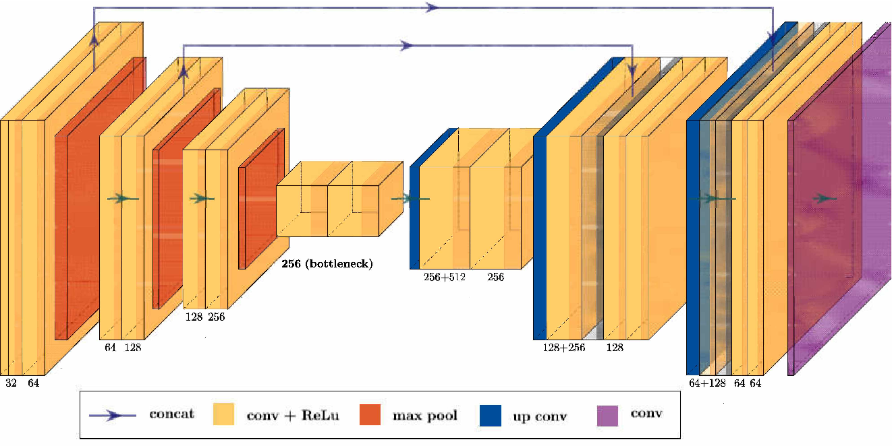


Dual Latent Space Method: U-net AutoEncoders
13
Latin Hypercube Sampling
Resample DAS using LHS to the same frequency as DTS
Does not require much training data to accurately predict parameters
Both the DAS U-net and DTS U-net have identical architectures
$$X$$
$$\hat{X}$$

Slide 14
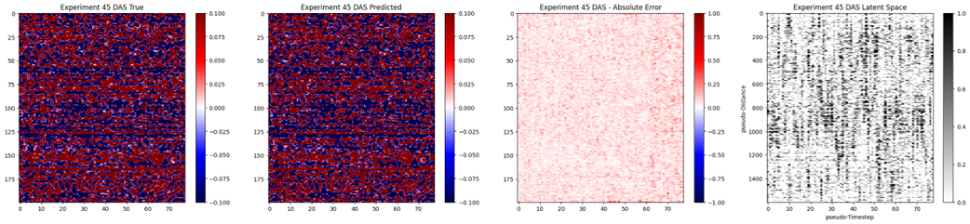
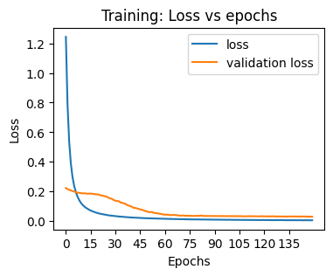
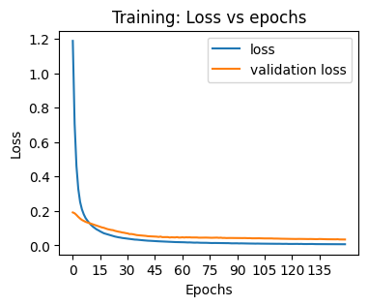
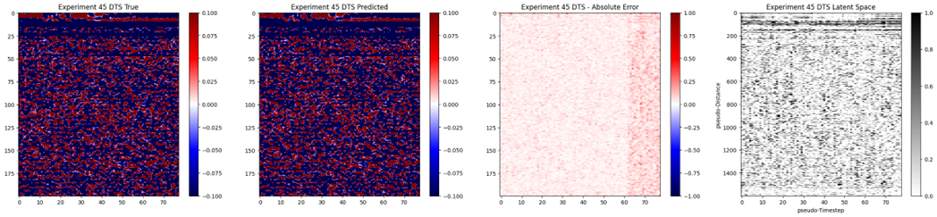
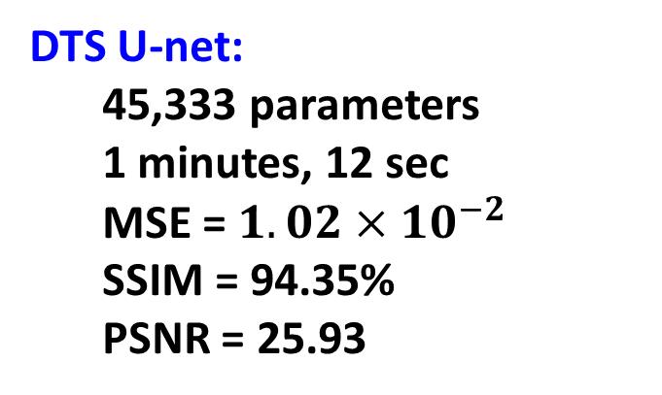
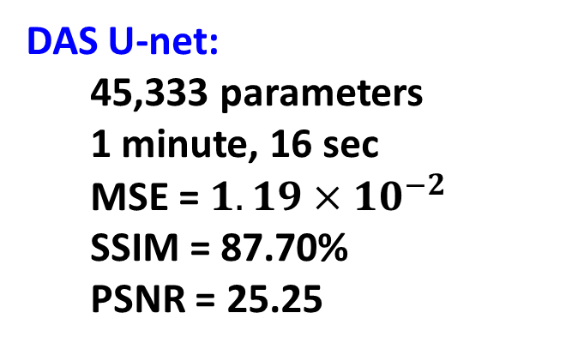
Dual Latent Space Method: Training Performance
14
True
Predicted
Abs. Error
Latent Space
DAS U-net:
45,333 parameters
1 minute, 16 sec
MSE = $1.19×{10}^{−2}$
SSIM = 87.70%
PSNR = 25.25
← DAS training performance
DTS training performance →
DTS U-net:
45,333 parameters
1 minutes, 12 sec
MSE = $1.02×{10}^{−2}$
SSIM = 94.35%
PSNR = 25.93

Slide 15
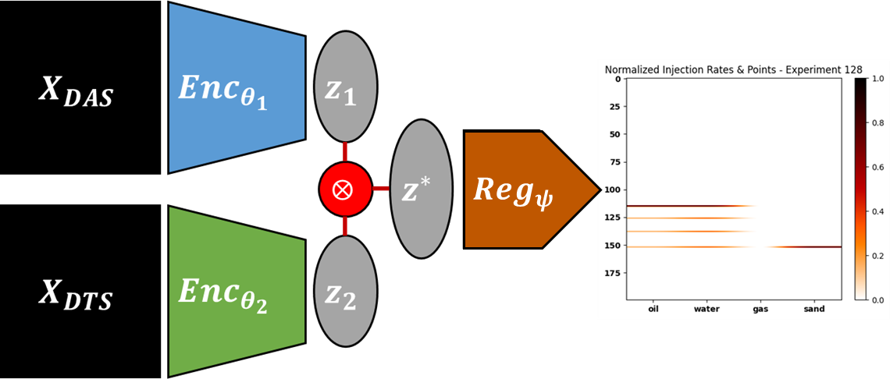

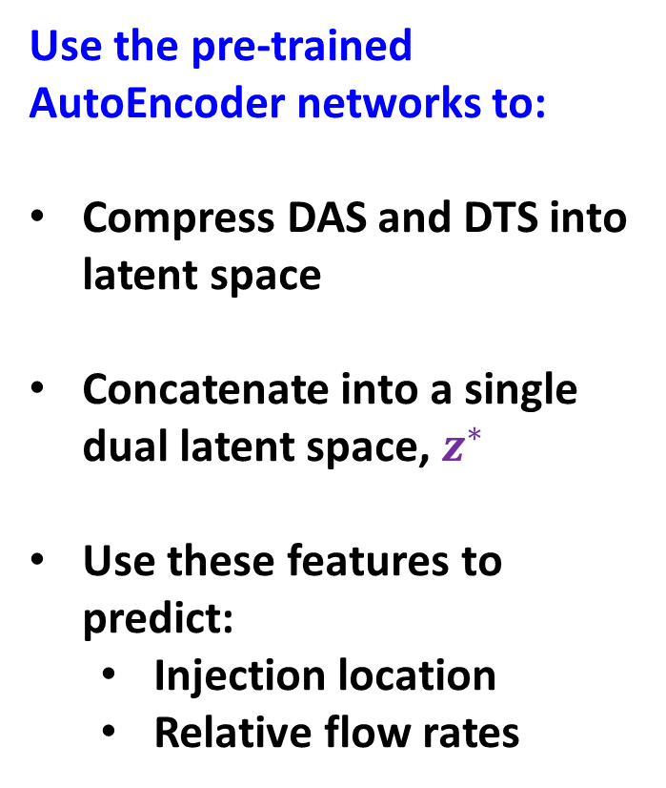

Dual Latent Space Method: Parameter Estimation
15
Use the pre-trained AutoEncoder networks to:
Compress DAS and DTS into latent space
Concatenate into a single dual latent space, $z^{∗}$
Use these features to predict:
Injection location
Relative flow rates
$$Reg$$
$$z_{1}=Enc_{θ_{1}}\left(X_{DAS}\right)$$
$$z_{2}=Enc_{θ_{2}}\left(X_{DTS}\right)$$
$$z^{∗}=\left[z_{1} ;z_{2}\right]$$
$$y=f\left(z^{∗}\right)$$

Slide 16
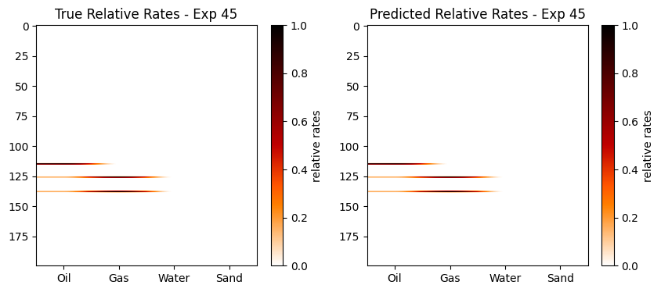
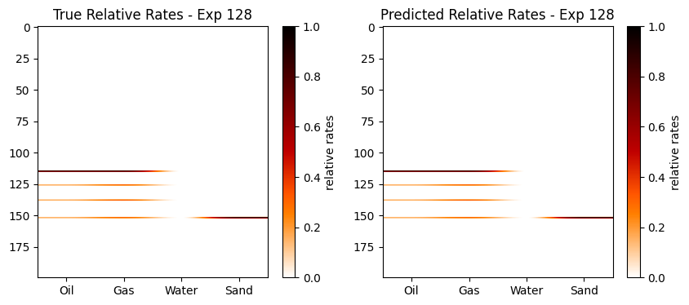


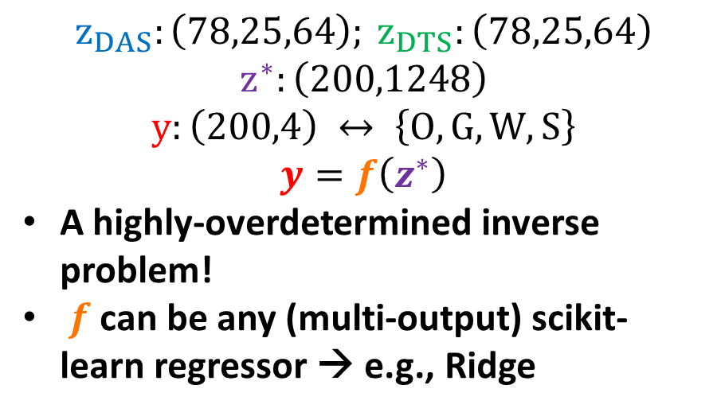



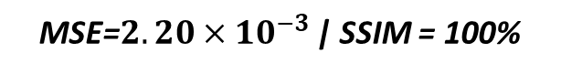
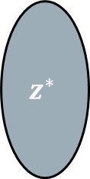
Dual Latent Space Method: Transfer Learning
16
$$z_{DAS}:\left(78,25,64\right); z_{DTS}:\left(78,25,64\right)$$
$$z^{∗}:\left(200,1248\right)$$
$$y:\left(200,4\right) ↔ \left\{O, G, W, S\right\}$$
$$y=f\left(z^{∗}\right)$$
A highly-overdetermined inverse problem!
$f$ can be any (multi-output) scikit-learn regressor → e.g., Ridge
MSE=$2.20×{10}^{−3}$ | SSIM = 100%
Transfer Learning (Testing) with new Experiment
$$z_{1}$$
$$z^{∗}$$
Rates
and
Locations
$$Reg$$
$$⨂$$
$$z_{2}$$
MSE=$2.58×{10}^{−3}$ | SSIM = 99.99%

Slide 17
Results and Discussion
17
Dual Latent Space Model captures hidden physics and dynamics in the spatio-temporal data
Tailored (learned) parameters to extract main features from the data
Flow Rate and Injection Location predictions in 0.6 seconds from dual (pre-processed) DAS and DTS measurements
Accuracy over 99%, even for transfer learning process

Slide 18
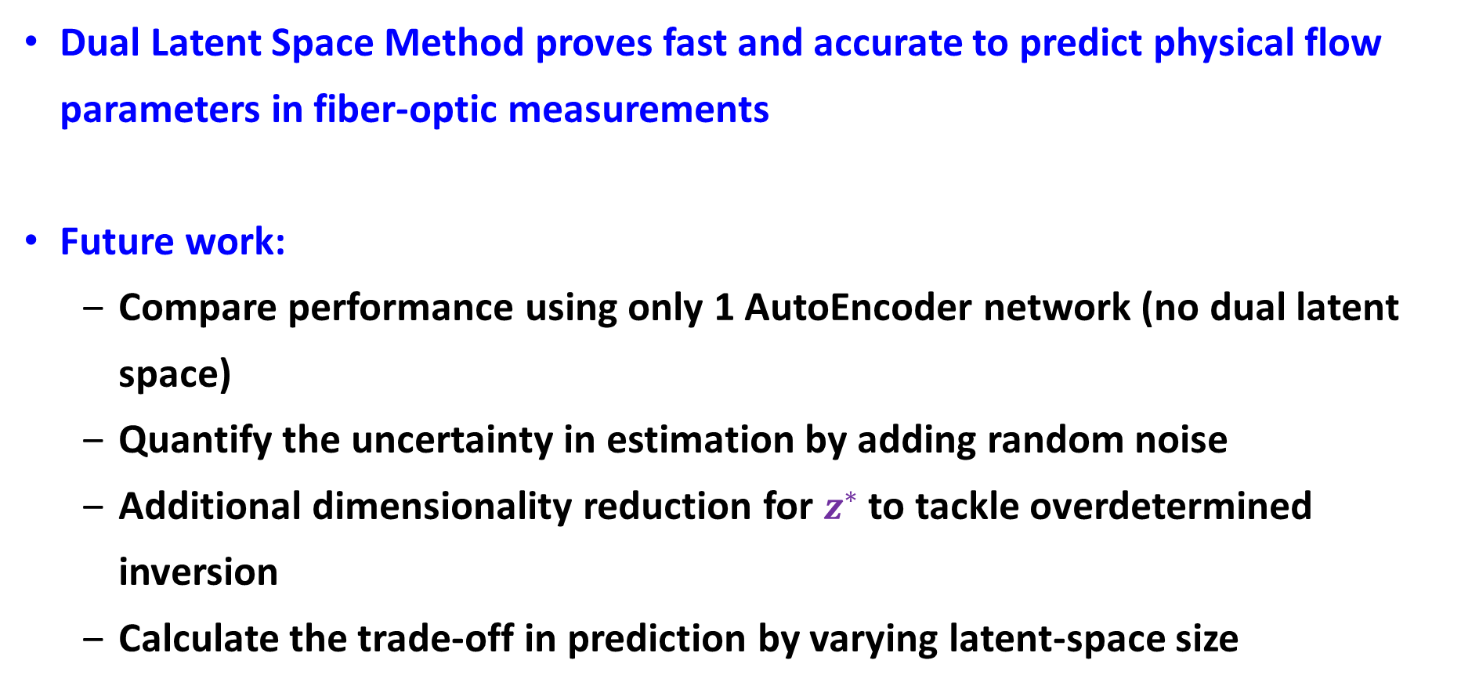
Conclusions and Future Work
18
Dual Latent Space Method proves fast and accurate to predict physical flow parameters in fiber-optic measurements
Future work:
Compare performance using only 1 AutoEncoder network (no dual latent space)
Quantify the uncertainty in estimation by adding random noise
Additional dimensionality reduction for $z^{∗}$ to tackle overdetermined inversion
Calculate the trade-off in prediction by varying latent-space size

Slide 19

Acknowledgments
19

Slide 20
References
20
[1] Mateeva, A., Lopez, J., Chalenski, D., Tatanova, M., Zwartjes, P., Yang, Z., Bakku, S., de Vos, K., and Potters, H., 2017, “4D DAS VSP as a tool for frequent seismic monitoring in deep water”, Leading Edge, Tulsa, Oklahoma, v. 36, n. 12, p. 995-1000.
[2] Zwartjes, P., Mateeva, A., Chalenski, D., Duan, Y., Kiyashchenko, D., and Lopez, J., 2018, “Frequent, multi-well, stand-alone 3D DAS VSP for low-cost reservoir monitoring in deepwater”, SEG International Exposition and Annual Meeting, Anaheim, California, October.
[3] Luo, B., Lellouch, A., Jin, G., Biondi, B., and Simmons, J., 2021, “Seismic inversion of shale reservoir properties using microseismic-induced guided waves recorded by distributed acoustic sensing”, Geophysics, v. 86, n. 4, p. R383-R397.
[4] Liu, F., Huff, O., Luo, B., Jin, G., and Simmons, J., 2022, “Convolutional neural network-based classification of microseismic events originating in a stimulated reservoir from distributed acoustic sensing data”, Geophysical Prospecting, v. 70, n. 5, p. 904-920.
[5] Feng, Q., and Li, Y., 2022, “Denoising deep learning network based on singular spectrum analysis – DAS seismic denoising with multichannel SVDDCNN”, IEEE Transactions on Geoscience and Remote Sensing, v. 60, p. 1-11.
[6] Binder, G., and Tura, A., 2020, “Convolutional neural network for automated microseismic detection in downhole distributed acoustic sensing data and comparison to a surface geophone array”, Geophysical Prospecting, v. 68, n. 9, p. 2770-2782.
[7] Zhong, T., Cheng, M., Lu, S., Dong, X., and Li, Y., 2022, “RCEN: a deep-learning-based background noise suppression method for DAS-VSP records”, IEEE Geoscience and Remote Sensing Letters, v. 19, p. 1-5.
[8] Tsuji, T., Ikeda, T., Matsuura, R., Mukumoto, K., Lawrens Hutapea, F., Kimura, T., Yamaoka, K., and Shinohara, M., 2021, “Continuous monitoring system for safe managements of CO2 storage and geothermal reservoirs”, Scientific Reports, v. 11, n. 1, p. 19120-19120.
[9] Maio, V., Gribik, A., Patterson, M., and Boardman, R., 2010, “Nuclear-integrated oil sands recovery via steam-assisted gravity drainage”, Idaho National Lab Reports, n. 23843, p. 8-12.
[10] Naldrett, G., Cerrahoglu, C., and Mahue, V., 2018, “Production monitoring using next-generation distributed sensing systems”, Petrophysics, v. 59, n. 4, p. 496-510.

Slide 21
Thank You
Q & A
August 14th-15th 2023
23rd Annual Formation Evaluation Research Consortium Meeting (2023)

Slide 22
Backup Slides
August 14th-15th 2023
A Deep Learning-based Dual Latent Space Method for the Estimation of Physical Flow Properties from Fiber-Optic Measurements
23rd Annual Formation Evaluation Research Consortium Meeting (2023)

Slide 23

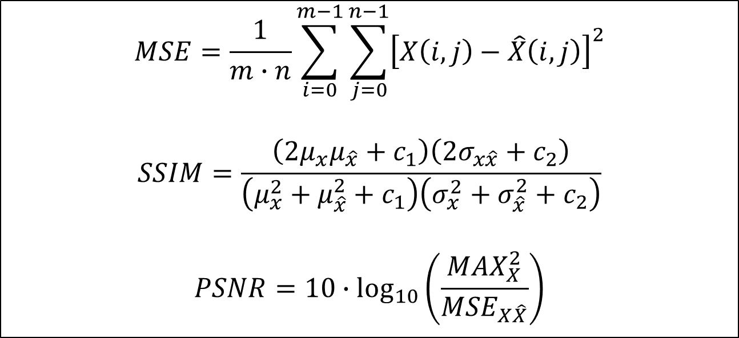
Backup Slides
23
$$MSE=\frac{1}{m∙n}\sum_{i=0}^{m−1}{\sum_{j=0}^{n−1}{{\left[X\left(i,j\right)−\hat{X}\left(i,j\right)\right]}^{2}}}$$
$$SSIM=\frac{\left(2μ_{x}μ_{\hat{x}}+c_{1}\right)\left(2σ_{x\hat{x}}+c_{2}\right)}{\left(μ_{x}^{2}+μ_{\hat{x}}^{2}+c_{1}\right)\left(σ_{x}^{2}+σ_{\hat{x}}^{2}+c_{2}\right)}$$
$$PSNR=10∙\log_{10}\left(\frac{MAX_{X}^{2}}{MSE_{X\hat{X}}}\right)$$
where $X$ is the original data matrix,
$\hat{X}$ is the reconstruction matrix,
and $c_{1}$ and $c_{2}$ are small stability constants

Slide 24
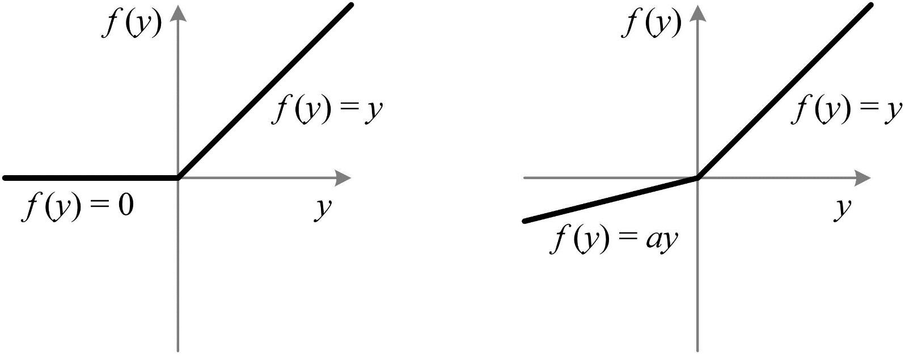
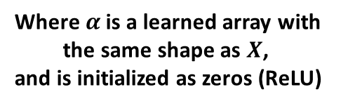
Backup Slides
24
ReLU PReLU
Rectified Linear Unit Parametric Rectified Linear Unit
Where $α$ is a learned array with the same shape as $X$,
and is initialized as zeros (ReLU)

